Slide 1
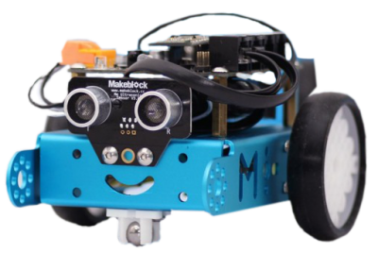
Intro to mBots
MODULE 4

Slide 2
Last Session
Operations (4 types)
Comparison operators (3 types)
Setting variables
If then condition
If then else condition

Slide 3
Variables
What can be stored as a variable?
Numbers, text…. What do we use variables for?
Variables allow us to store, change and access information as the program runs.
How are variables used in the world?
Computer games, supermarkets, car parks .. etc
Notes:
Can the kids think of samples of stored variables such as games? For keeping scores
How are variables used in the world? An illustration of a car leaving a car park. The automated barriers in a car park are programmed to use variables to check if any spaces are available. Variables can also be used to work out the cost of parking based on the length of time a car stays. Computer games In a computer game, things like lives and health are variables that constantly change. If you make a mistake you lose health or a life. But you can also gain lives and health by collecting items. Supermarkets A supermarket till could use variables to store information about all the items you buy. As more items are scanned the variable’s total would increase. This value will then be used to calculate how much you need to pay for your shopping. Car parks The program controlling the automated barriers in a car park could use variables to count cars in and out. These can then be used to see if there is any space to let more cars in.

Slide 4
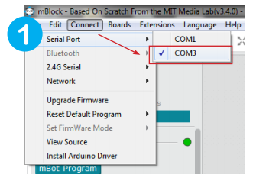
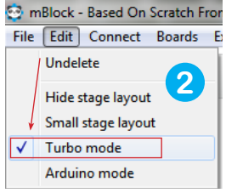
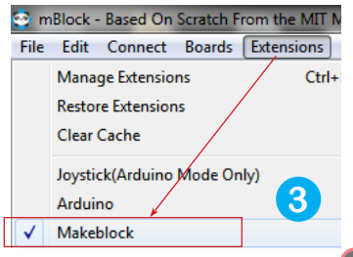
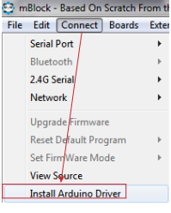
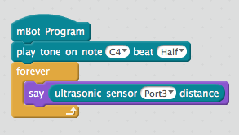
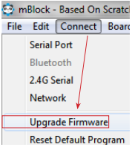
Plug in the mBot cable to the computer and turn the mBot on
Can’t see the serial port?
TEST Connection:

Slide 5

WARM UP Exercise
Make the robot go forward and stop when within 10cms of an obstacle
*Tip: use if statement

Slide 6
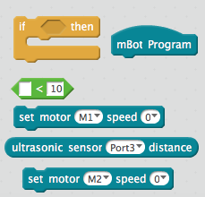
blocks
Make the robot go forward and stop when within 10cms of an obstacle
solution

Slide 7
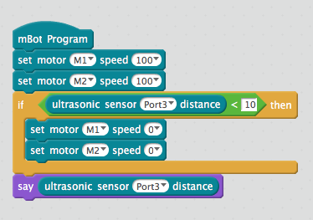
Sample solution

Slide 8


Sample solution
It has a bug!!
Notes:
The sample solution has a bug, can you point it?

Slide 9
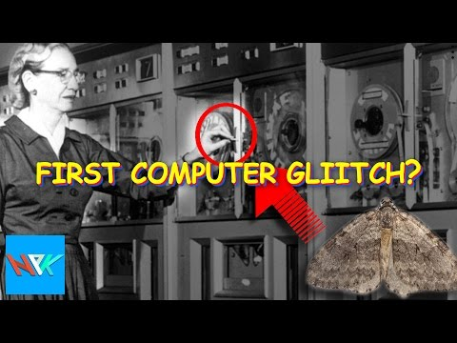
Aside

Slide 10

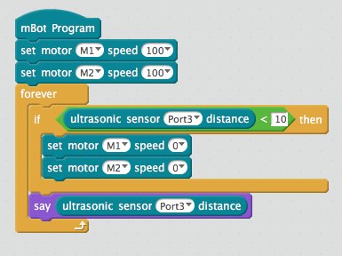
Fixing bug

Slide 11
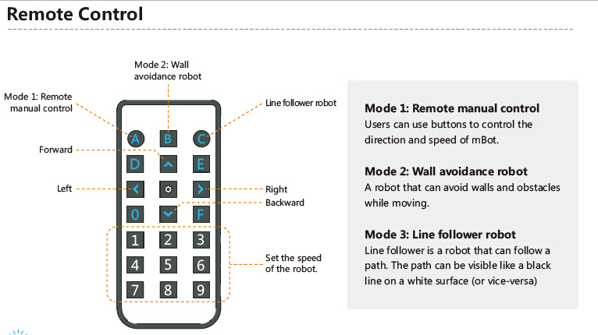
USING REMOTE CONTROL

Slide 12
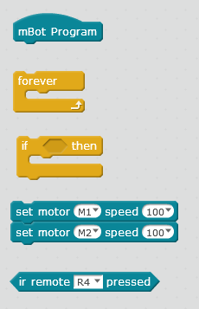
Exercise
1. Use the blocks below to assign following behaviour to Infrared Transceiver Module:
on 0 stop
on arrow up move forward
on arrow down move backwards
on arrow left move left
on arrow right move right
solution

Slide 13
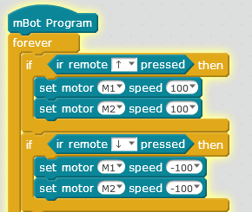
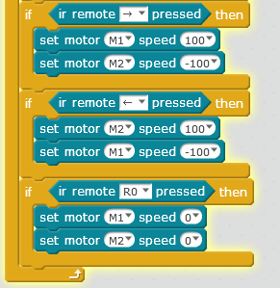
Sample solution

Slide 14


Challenge TASK:
Change speed
by setting A variable

Slide 15



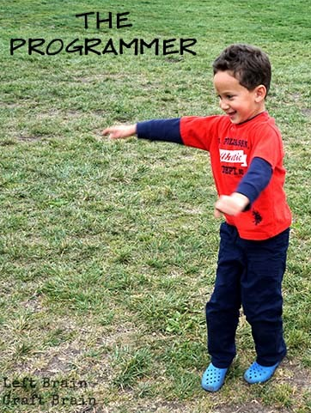
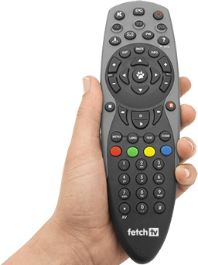
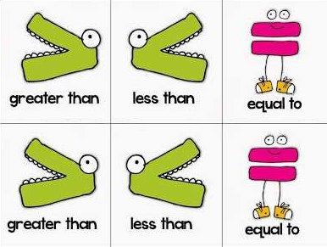
What have we learnt in the past two sessions?

Slide 16
What have we learnt today?
operations
Setting variables
If then condition
If then else condition
Origins of bug
Remote control
Light sensor

Slide 17

Thank you!
One Rule
Be Cool !

